Slide 1
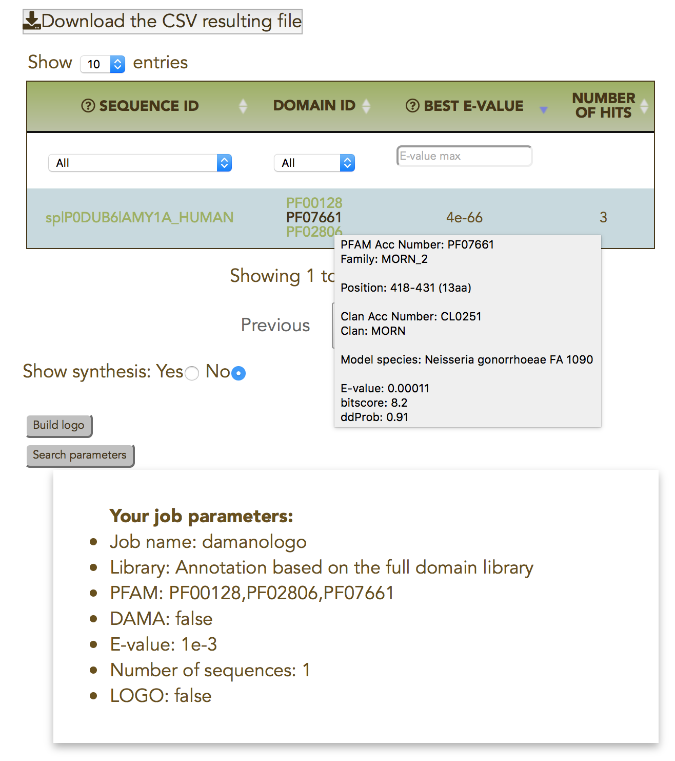
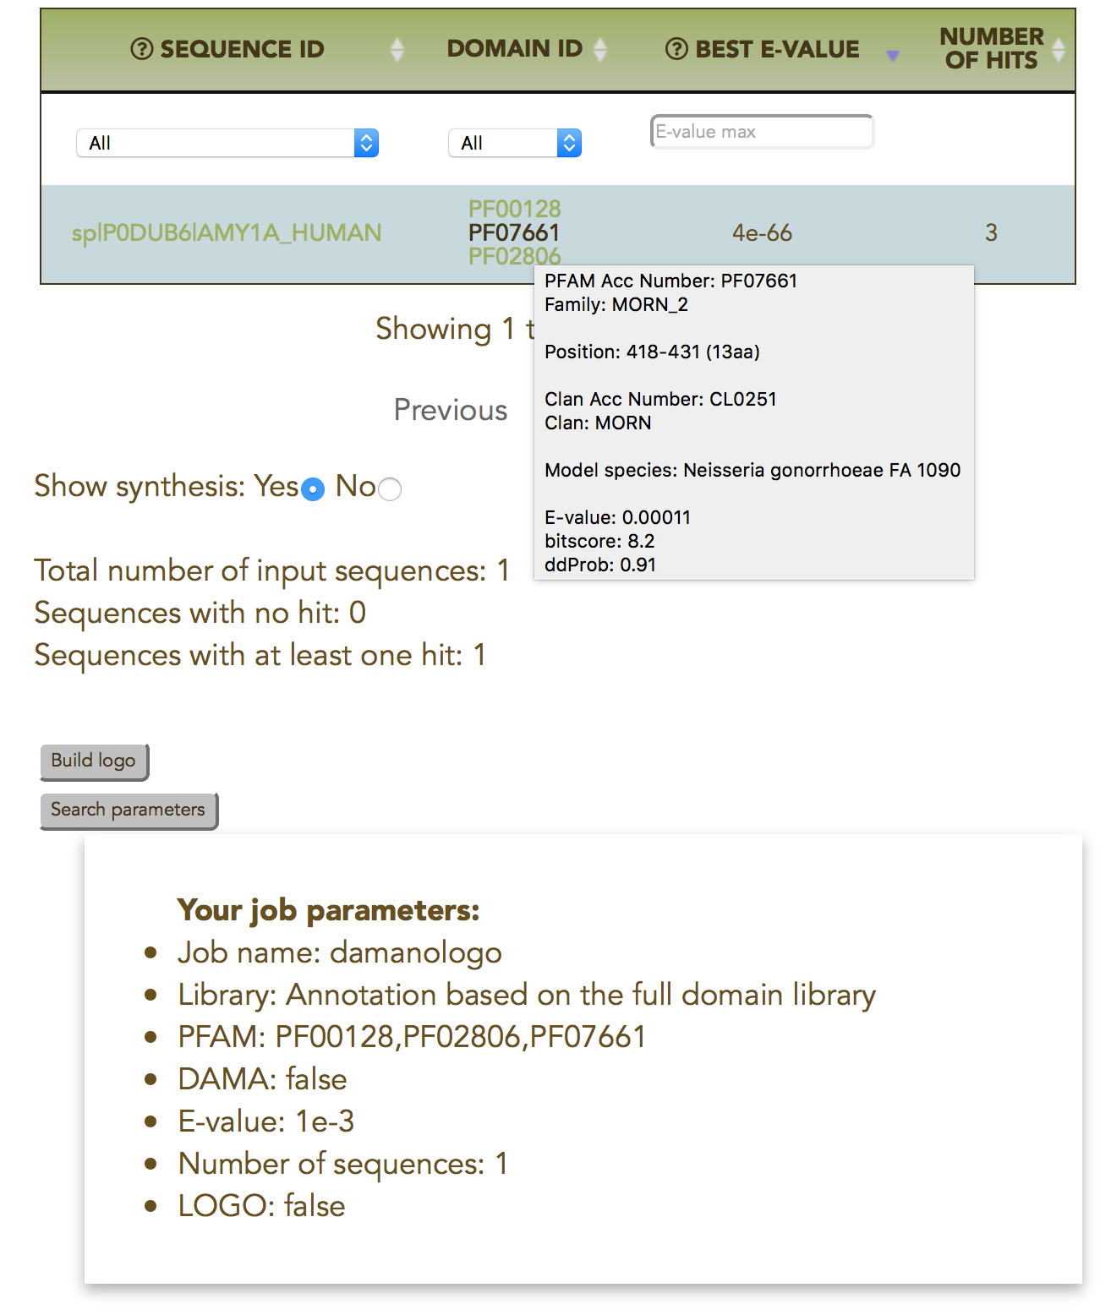


Slide 2
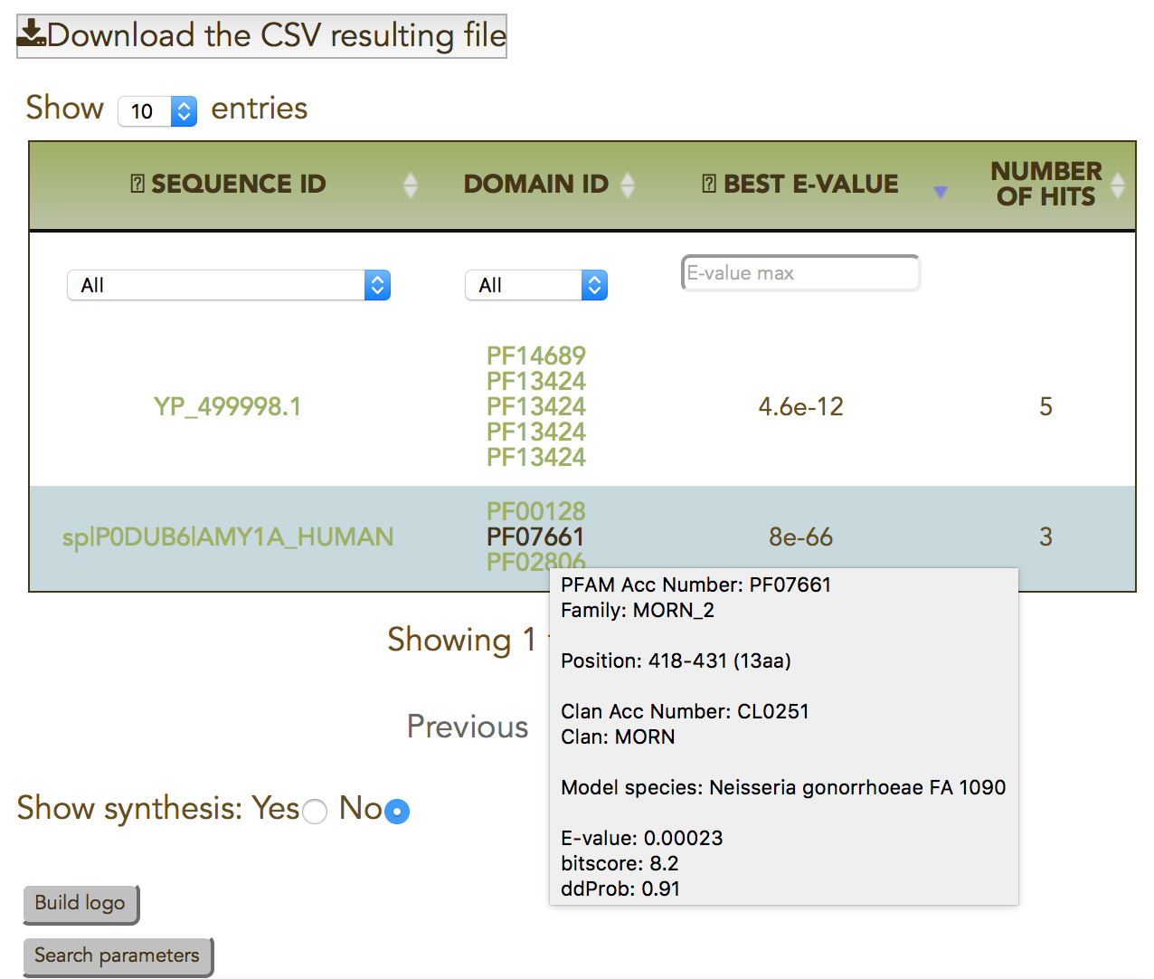
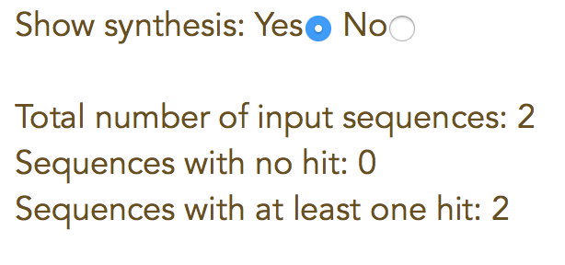
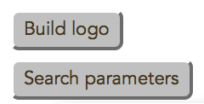
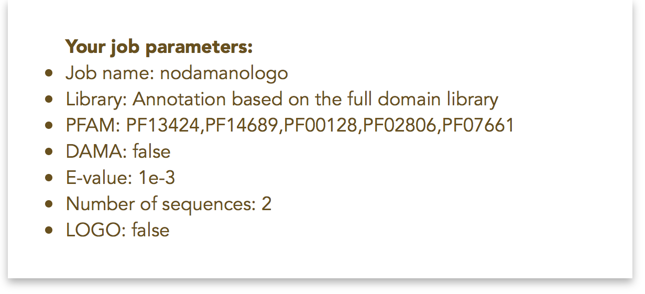

Slide 3
Tool | Plasmodium falciparum proteome | TitinLikeDB | SilkWormSet
DAMA computation time | 16 064s | 24 437s | 3.72s
Number of proteins | 5 542 | 1 553 | 324
Number of domain hits | 3 850 992 | 2 278 497 | 504 936
Reproduced from Table 2 in (Bernardes et al Bioinformatics 2016).

